Slide 1

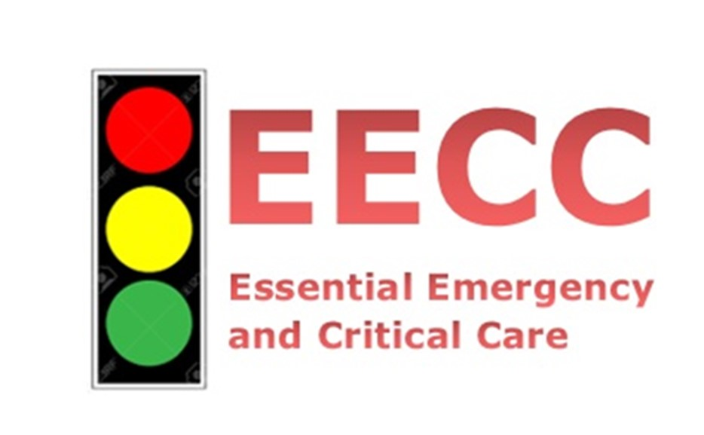


Essential Emergency and Critical Care
Tiba Okovu na Huduma Msingi kwa Wagonjwa Mahututi

Slide 2



Motorcycle driver, aged 25
Road traffic accident.
Arrives to health facility covered in blood.
Diagnosed as ”Polytrauma.”
Referred to hospital.
CT scan. Surgery.
Post-op on the general ward.
Pregnant mother: 40 weeks GA
Arrives to health facility unconscious.
Seizure
Diagnosed as ”Eclampsia.”
Emergency Caesarean.
A healthy baby is delivered.
To the ward.
2 year old boy
Arrives to health facility with reduced level of consciousness. High fever . Tested and diagnosed with severe Malaria
State-of-the-art treatment for malaria
Admitted.

Slide 3

Which one of these patients was critically ill? Why?

Slide 4

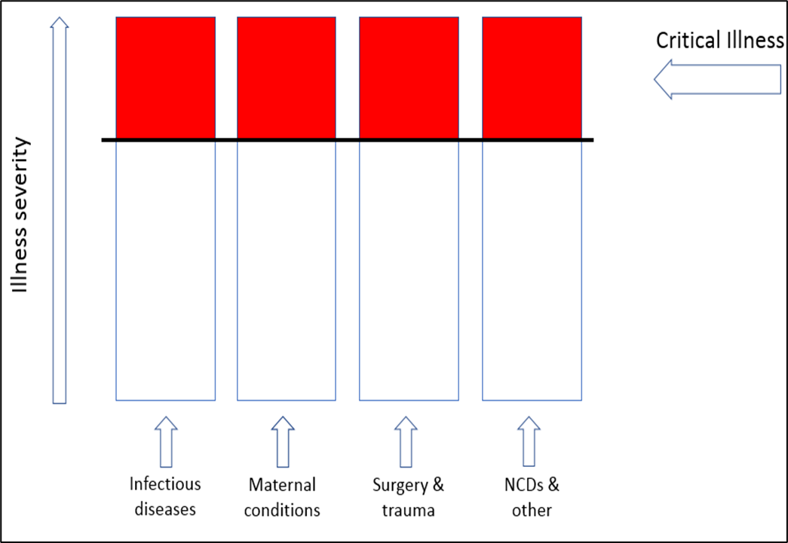
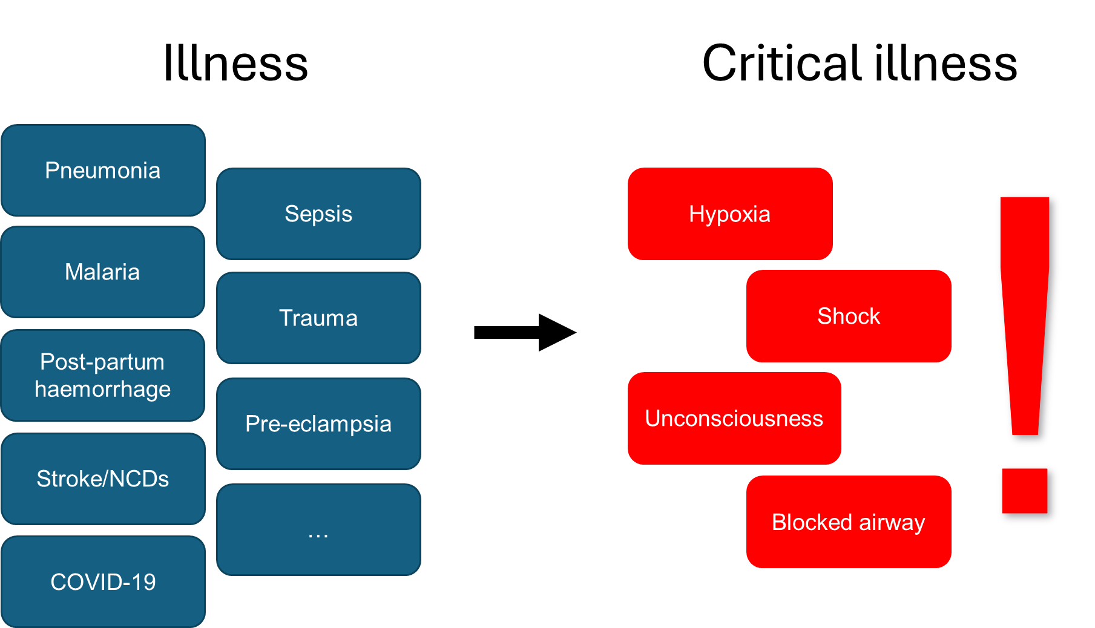
Critical illness
Critical illness is a state of ill health with
Vital organ dysfunction (eg: Heart, Brain, Lungs)
High risk of imminent death if care is not provided
Potential for reversibility
Anyone can become critically ill
Newborns
Children
Adolescents
Mothers,
Adults,
Elderly

Slide 5
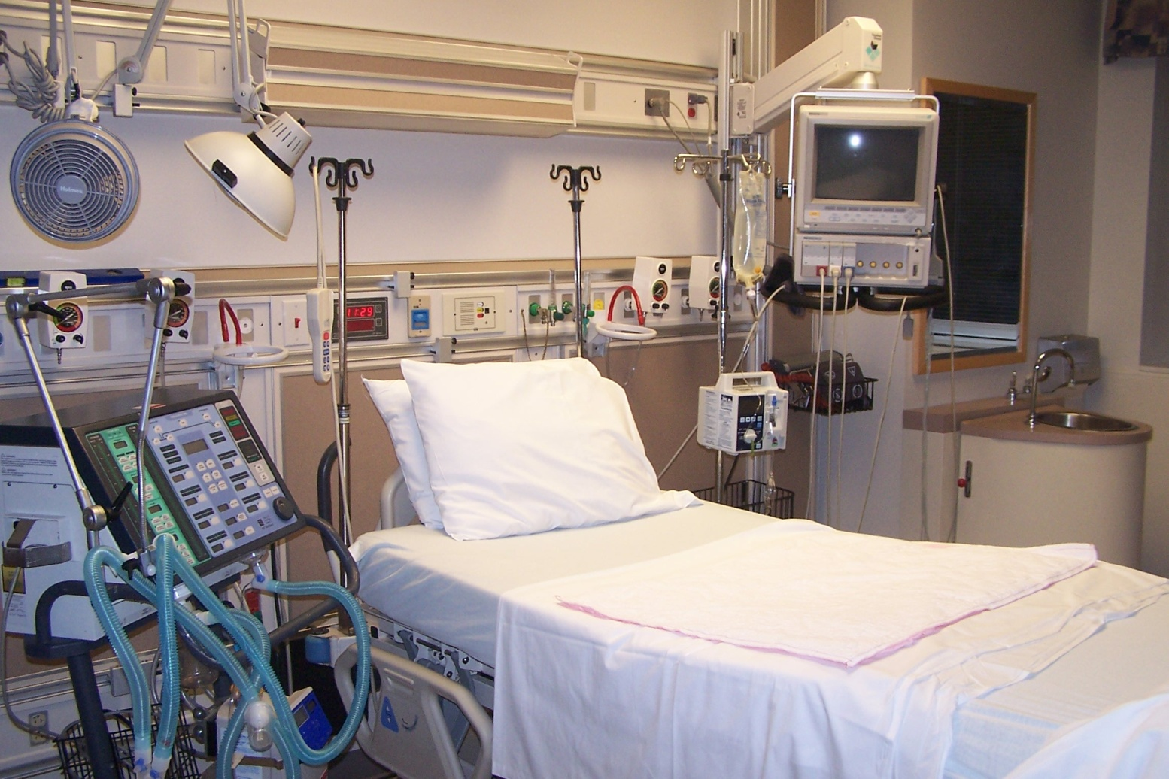
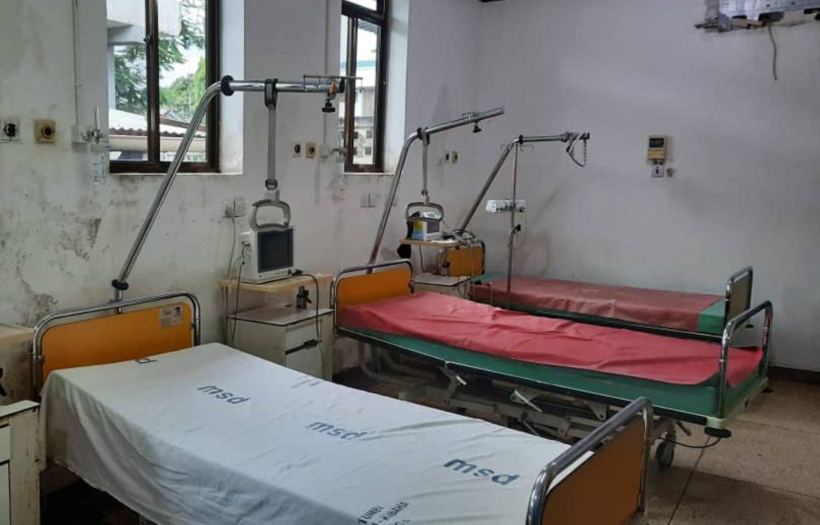


Critical Care and Resources for Critical care
Critical care is the identification, monitoring and treatment of patients with critical illness through the initial and sustained support of vital organ functions
Critical Care = Care of critical illness
Care depends on setting, hospital level and time-of-day
University
Hospitals
Regional Hospitals
District Hospitals
Critical Care ≠ ICU care

Slide 6
Baby Jackson
Our patients
Airway gets blocked.
Dies overnight.
Why did they die?
Lack of obstetric/trauma/malaria care?
- Maybe not.
Maria
Becomes hypotensive.
Dies overnight.
May be a lack of Essential Emergency and Critical Care
They became critically ill
They deterioratated and their critical illness was not identified in the ward
Fundamental care of critical illness care was not provided
Jackson
Develops hypoxia.
Dies overnight

Slide 7
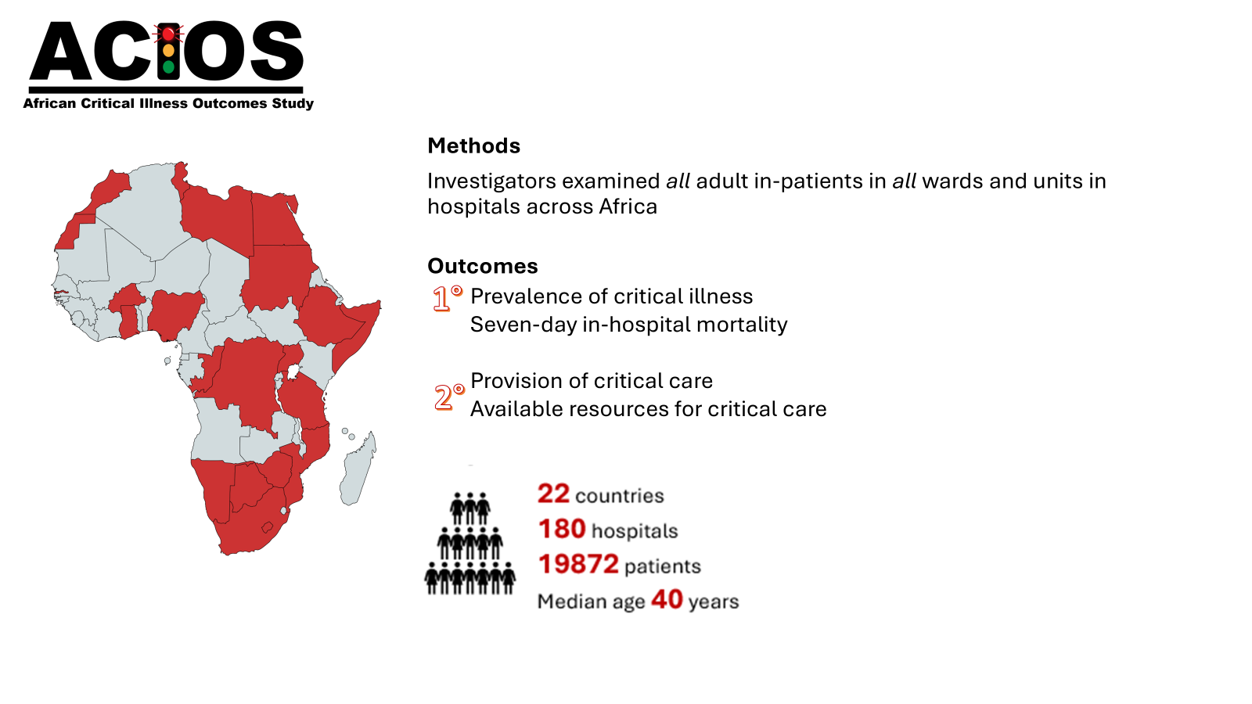
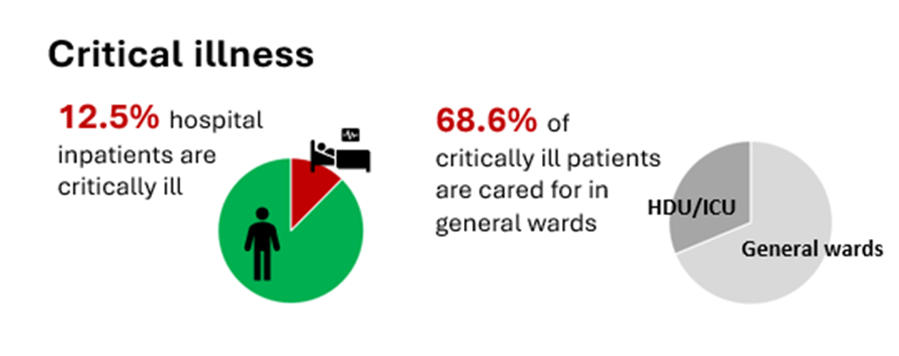
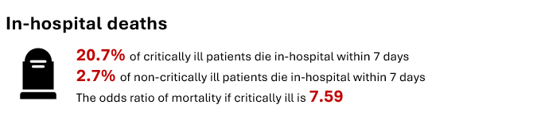
The burden of Critical illness

Slide 8

Where are the critically ill Patients ?
Critical illness occurs throughout health systems
In emergency units, general wards, theatres, HDUs, ICUs and in the community
Among in-patients, most critically ill patients are cared for in general wards
97 % of critically-ill in-patients in Malawi are in the general wards
83% of critically-ill in-patients in Sweden are in the general wards
68.6% of in-patients in African Hospitals are in general ward

Slide 9

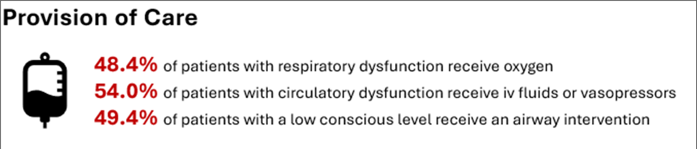
Is critical care currently provided?

Slide 10
Is critical care currently provided?
Among 1000 patients in two hospitals in Malawi ¹
Hypoxia
    45 (4% ) were hypoxic (sat<90%)
    Only 5/45 (11%) were receiving oxygen. 90 % were not
Hypotension
    103 (9%) were hypotensive (sbp<90mmHg)
    Only 9/103 (9%) were receiving IV fluids. 91 % were not
    `
Unconsciousness
    17 (1.5% ) were unconscious (GCS<9)
    Only 8/17 (47%) either had a protected airway or were in the recovery position 53% were not

Slide 11
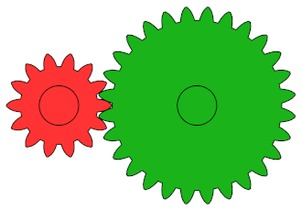
The Solution
The need to change how critical illness is understood and critical care is provided
The need of unified approach for care of the critical illness relevant for:
All patients
All specialties
All settings
All Initiatives

Slide 12

The Concept of Essential Emergency and Critical Care
(EECC)

Slide 13
Essential Emergency and Critical Care
EECC is the most simple, first-line form of care for critically ill patients
It is “the care that all critically ill patients should receive in all hospitals in the world”
All patients = irrespective of age, gender, diagnosis or social status
EECC specifies the minimum standards of care required in critical illness
A concept and systems innovation

Slide 14
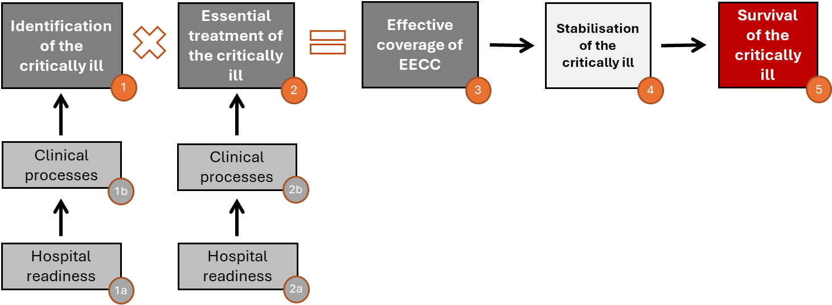
EECC conceptual framework

Slide 15


Critical care: levels of complexity and cost
Examples
ECMO
CRRT
Mechanical Ventilation
Advanced Emergency and Critical Care
Complexity & cost of care
CPAP
Vasopressors
Intermediate Emergency and Critical Care
Airway protection
Oxygen
Intravenous fluids
Triage & monitoring
Essential Emergency and Critical Care
Emergency
Unit
Operating Theatre
ICU
Ward

Slide 16
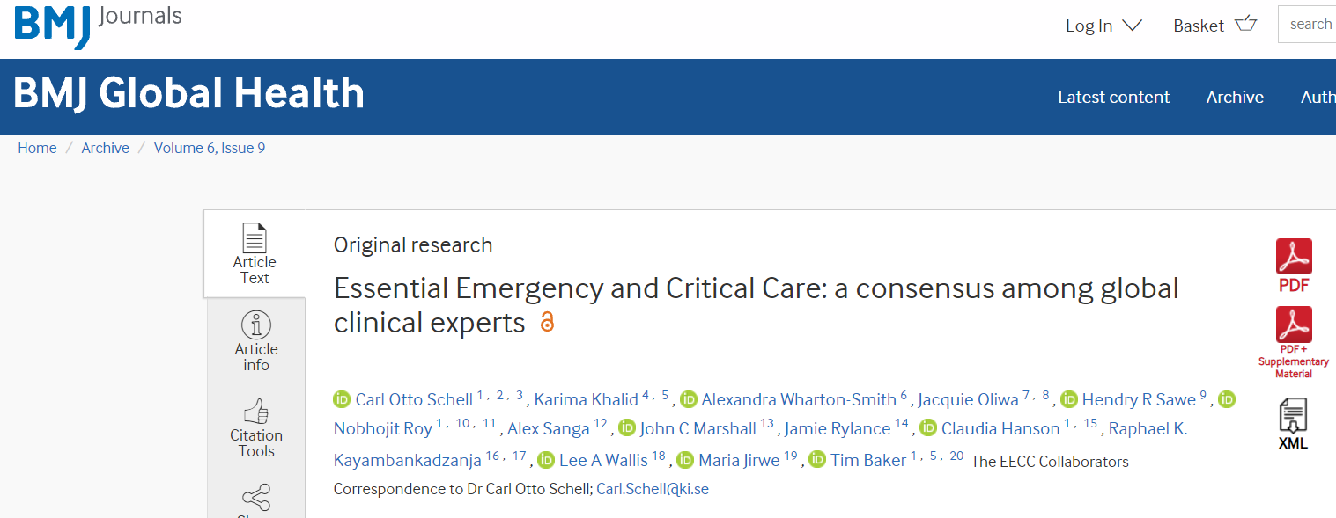
Consensus around the content of EECC
Delphi consensus
269 clinical experts from different acute care disciplines and resource settings
    From LIC (67%), MIC and HIC
    Clinical expertise from emergency care, intensive care, medicine, surgery, paediatrics, obstetrics etc…
40
Clinical processes
66
Hospital readiness requirements

Slide 17
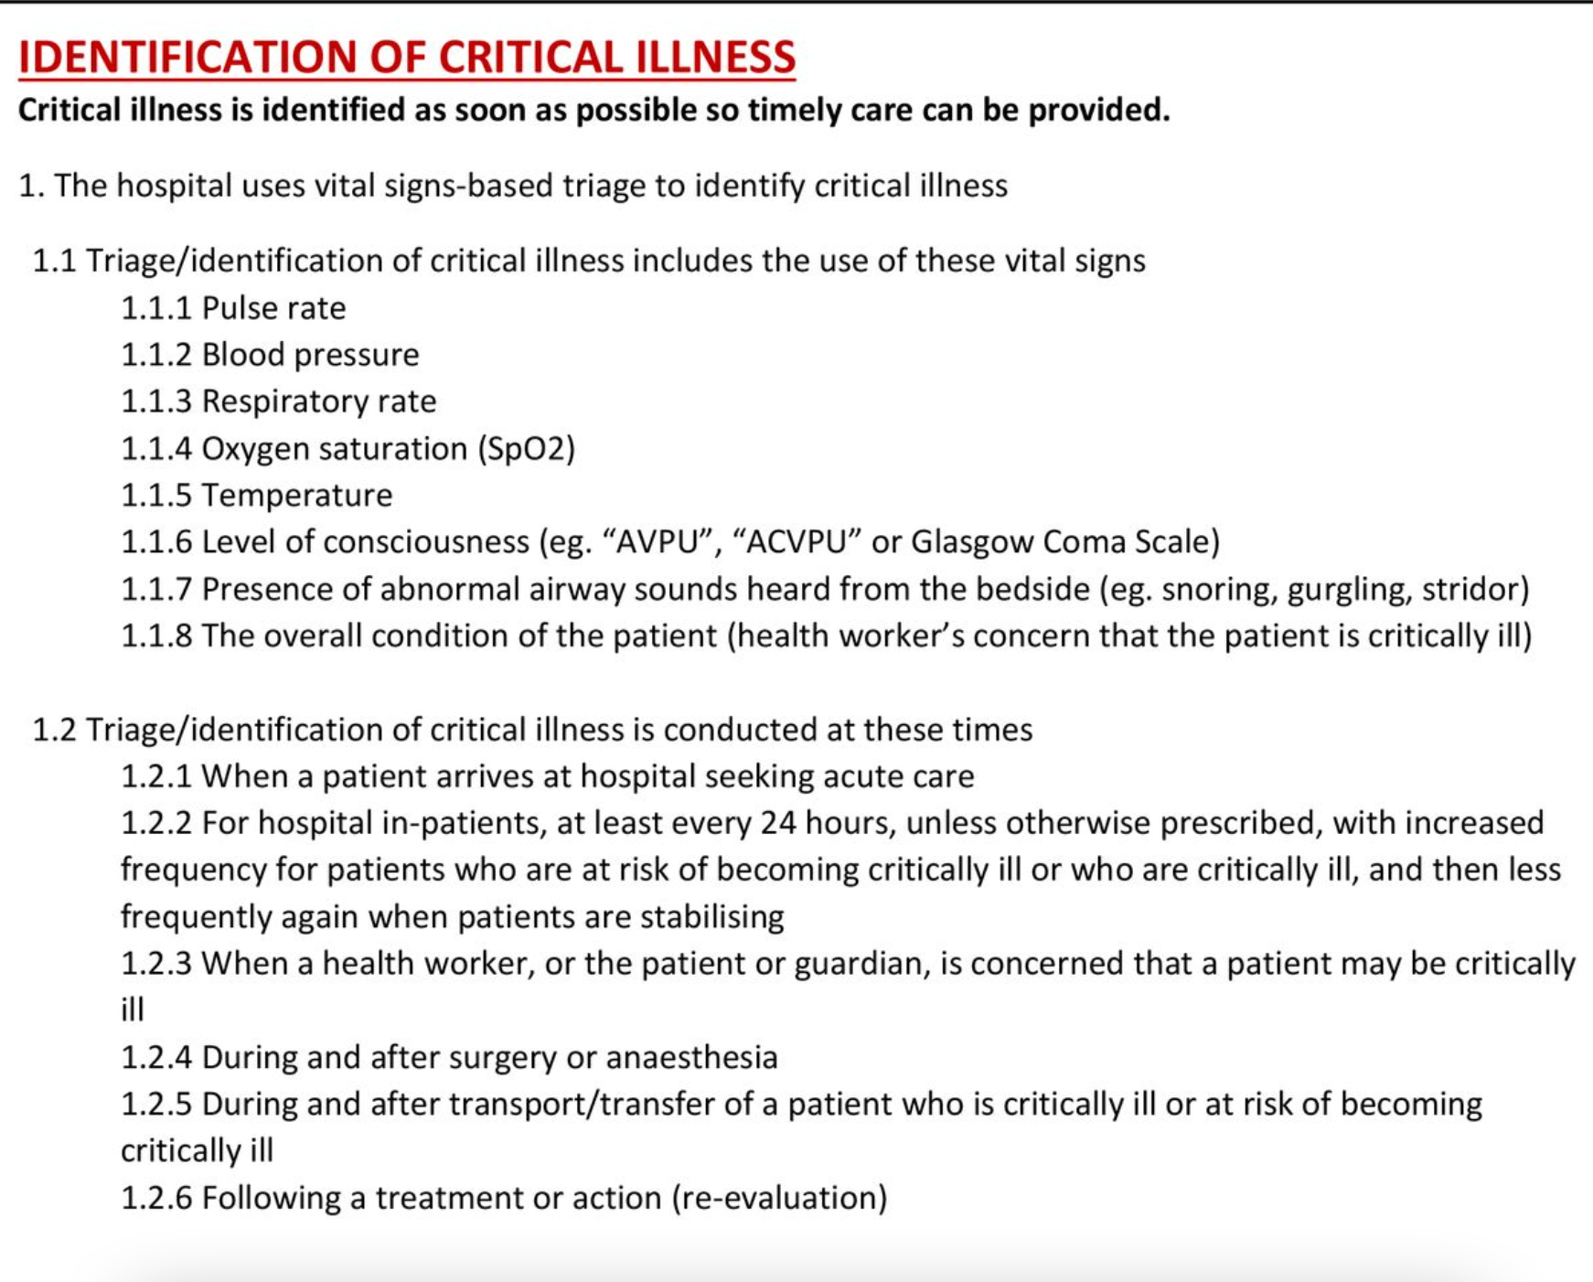
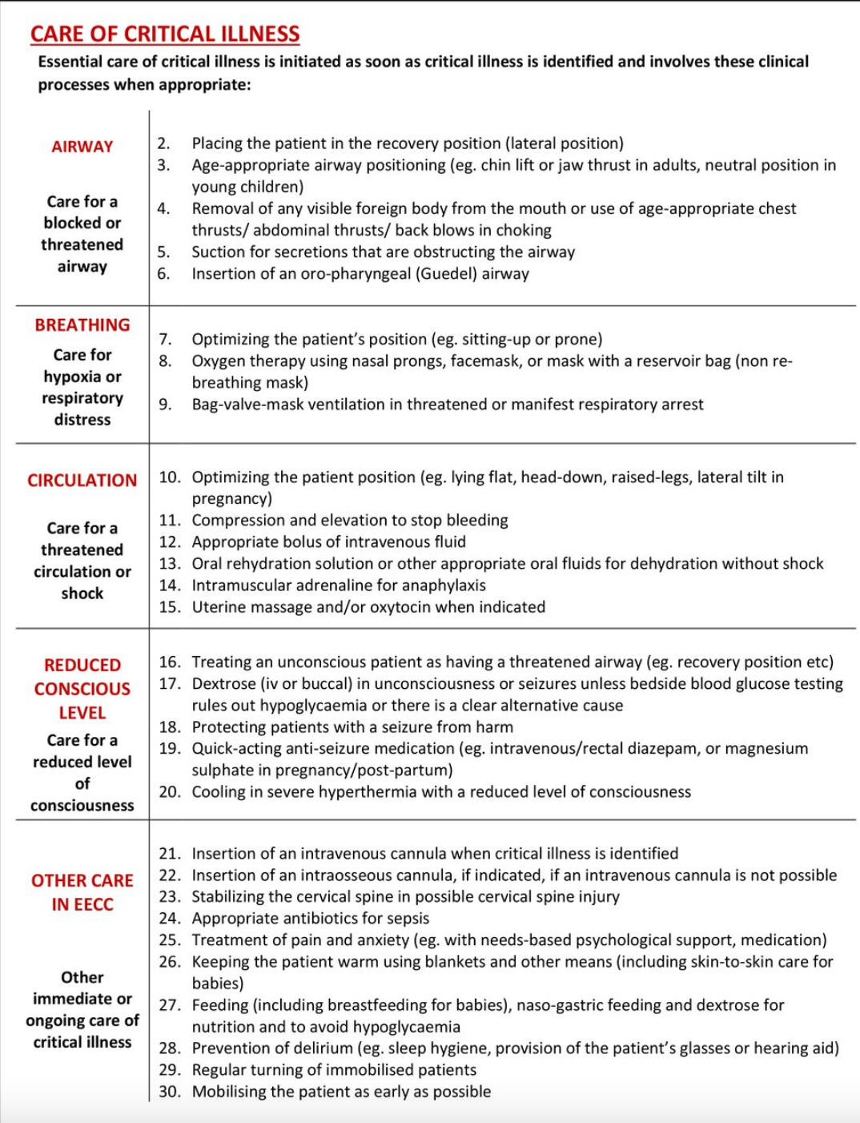
EECC clinical processes
  40 clinical processes
    e.g. triage/identification emergency units and wards, oxygen treatment (but not blood transfusion or CPAP)

Slide 18
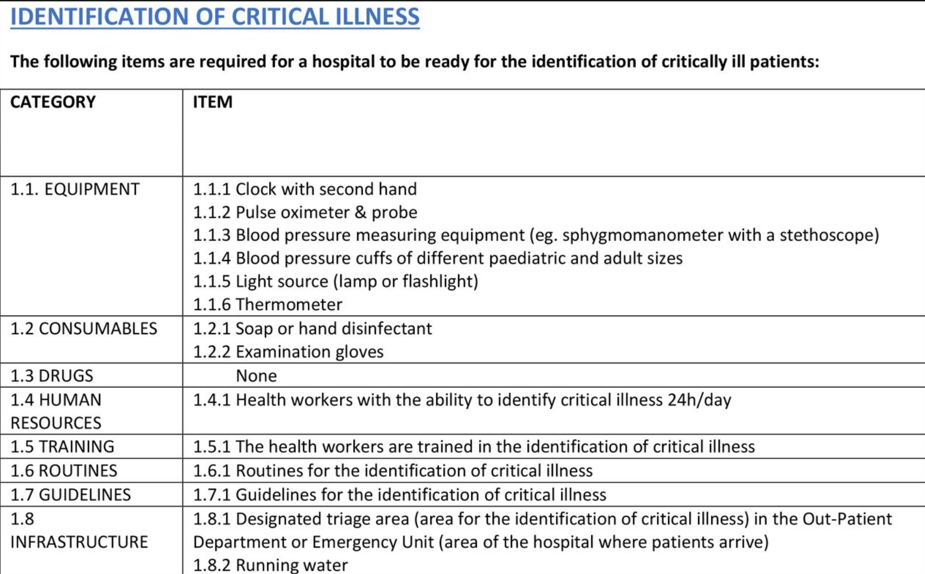
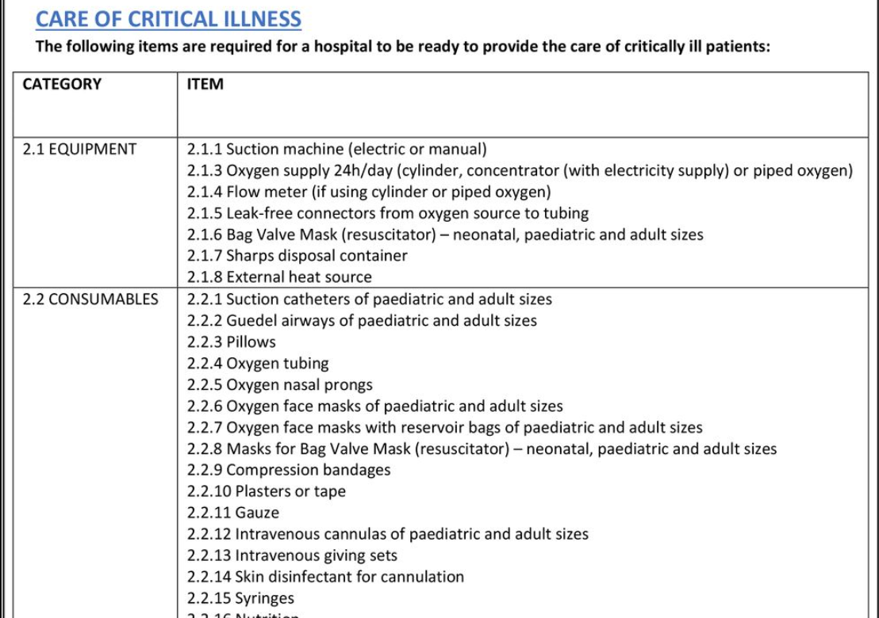
Consensus around the content of EECC
  66 hospital readiness requirements
    Equipments, consumables, HR, drugs, routines, guidelines, infrastructure
    e.g. pulse-oximeters, iv-giving sets.

Slide 19
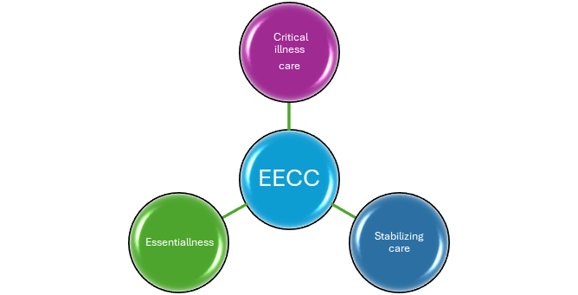
Principles of EECC
Critical illness Care
EECC aims to increase focus & quality of care for critical illness
Limited to the care of critically ill patients.
EECC does not include care for non-critically ill (stable) patients (even if that is also important care).
Essentialness
First-line, basic, effective, low-cost care
Not advanced care or aspirational care, in any specialty or discipline.
EECC is essentialness in the care of critically ill patients
does not attempt to provide care beyond the essentials
Examples: EECC includes oxygen, but does not include mechanical ventilation
Stabilising vital organ function
Life-saving care
Needed to support vital organs and keep the patient alive
Neglected and requires greater focus than what is currently given.
EECC is not diagnosing or providing definitive care of the underlying pathology.
Examples: EECC includes pulse oximetry but does not include tissue biopsies or appendectomy.

Slide 20

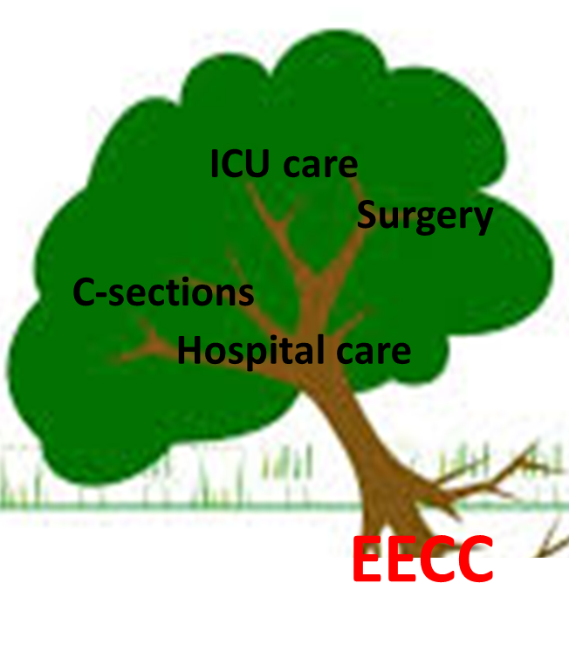
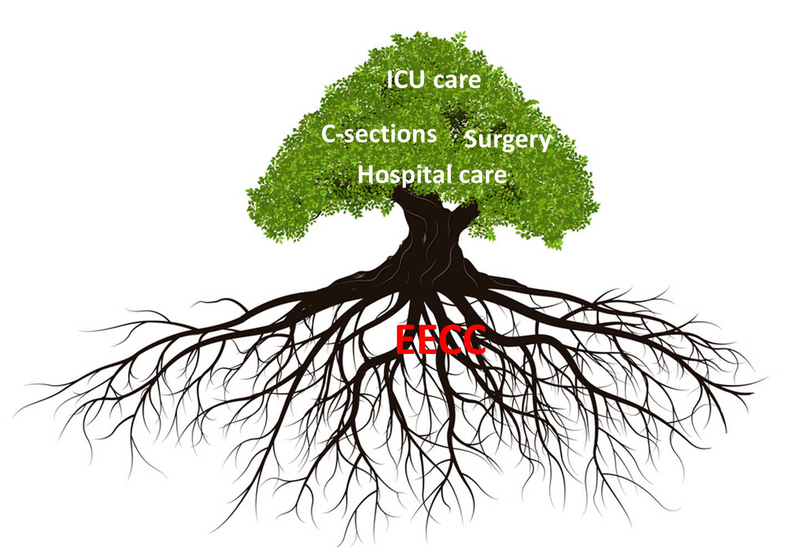
Current state
Where we are
Where we want to go
Storm:
Pandemic
Financial
Too many patients
HR crisis
Storm:
Pandemic
Financial
Too many patients
HR crisis

Slide 21
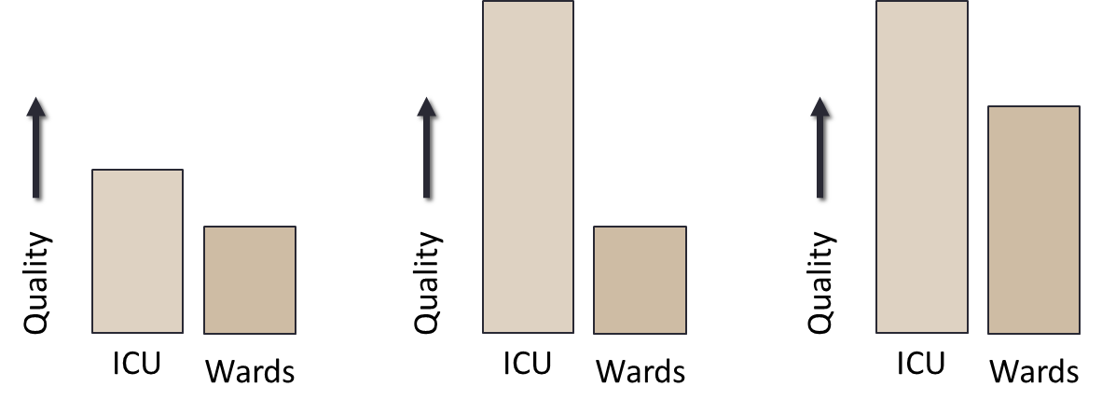


ICU scale up vs EECC scale up
Current status; Low quality of care in ICU and Ward
Improving ICU care alone→ large gap of scare btn ICU and wards
EECC rollout improves the overall care of critical illness and narrow the gab between ICU and wards, reduce demand for ICUs and increases cost effectiveness

Slide 22
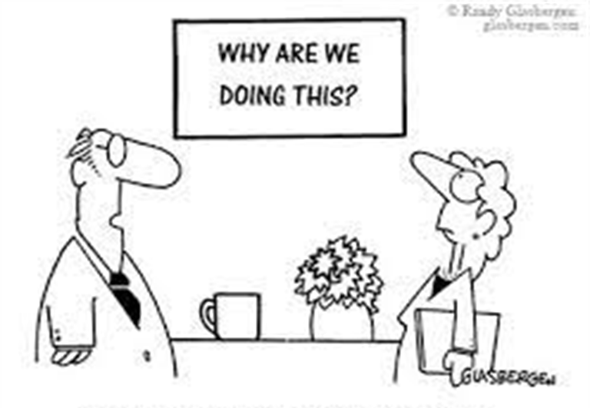
SUMMARY
Critical illness is common
There is a substantial unmet need of critical care in hospitals
For real-world impact, all hospitals should prioritize the provision of low-cost, cost-effective EECC
Large potential for averting deaths, estimated at 1 million (0.5-2.1)
Vision
All critically ill patients receive EECC in all hospitals in the world so that no patient dies from a cause that EECC could prevent.

Slide 23
THANK YOU

